Slide 1
MODEL STRUCTURE

Slide 2
All of the data used in this analysis was collected from the U.S. Bureau of Labor Statistics. The data collected are measurements in the thousands for injuries and fatalities. The data for all possible US job sectors was collected for the years 2011 through 2018. This data was then normalized with the total employed individuals for each sector. For example: total female gender fatalities in the farming industry was normalized with the total number of females employed in the farming industries, therefore, giving a probability of fatality. This same probabilistic normalization was also done for the injury data as well. This normalization allows for the ability to perform correlations between all, of the possible sources of data.
Subsequently, a nonlinear regression for the data collected was also performed. All regressions yielded three values A,B,C which fit the following equation:
Probability = A * e^{(B*X)} + C

Slide 3
A final model will be created, such that the probability of fatality(PF) or injury(PI) can be predicted based on the following variable: occupation, gender, age, race, and length of service.
P_{fatality} = PF _{gender} (occupation) * PF _{age} (occupation) * PF _{race} (occupation)
P_{injury} = PI _{gender} (occupation) * PI _{age} (occupation) * PI _{race} (occupation)

Slide 4
INDIVIDUAL PLOTS

Slide 5
Fatalities (probability vs industry)

Slide 6
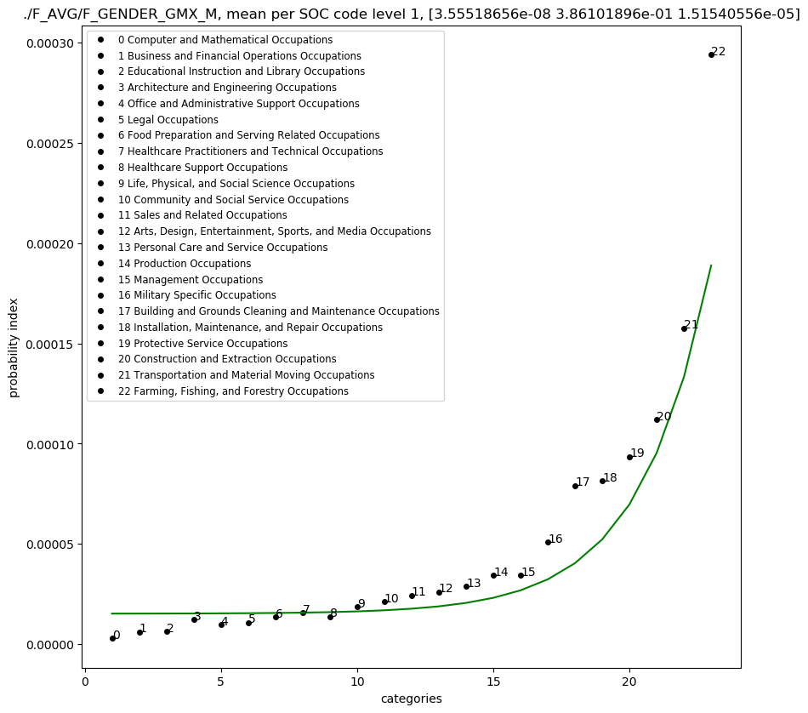
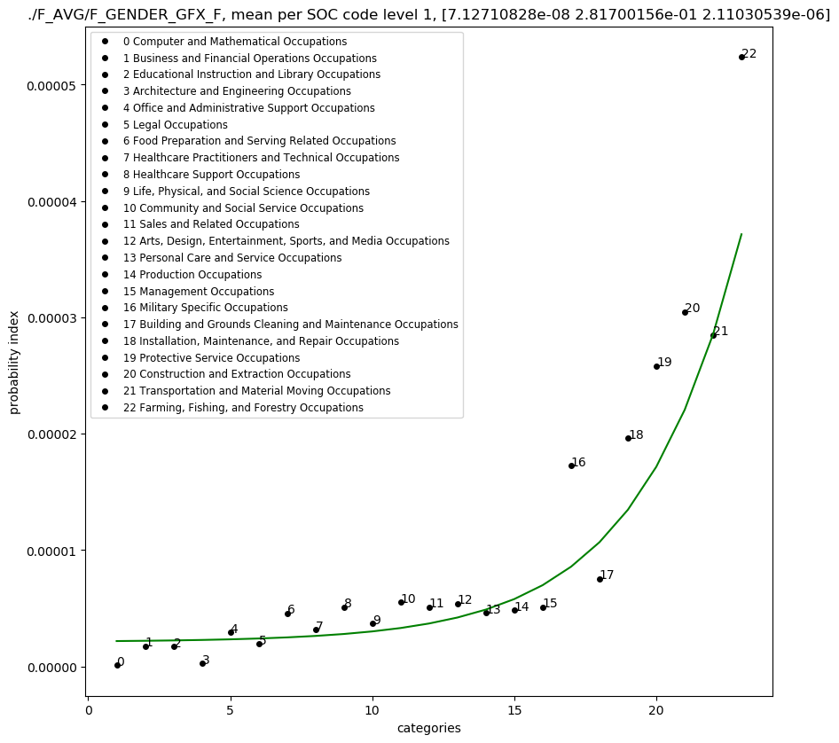
F_GENDER, sorted for fatalities

Slide 8
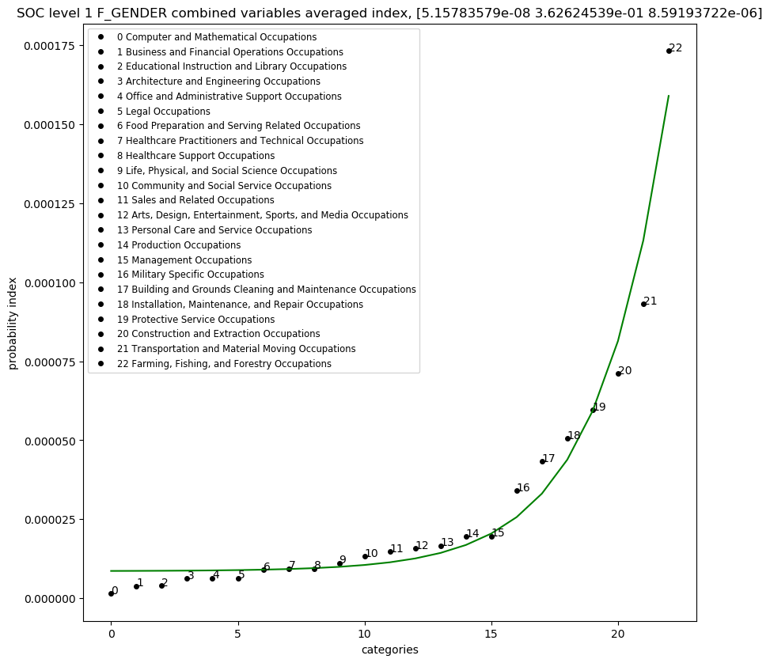
ALL F_GENDER, sorted for fatalities

Slide 9
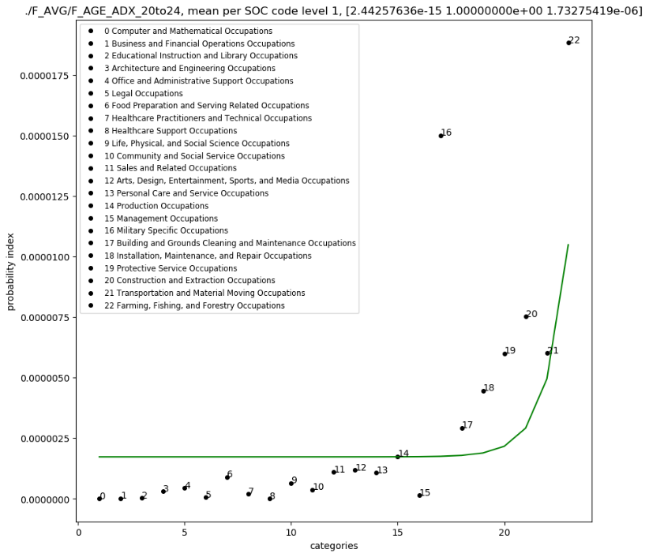
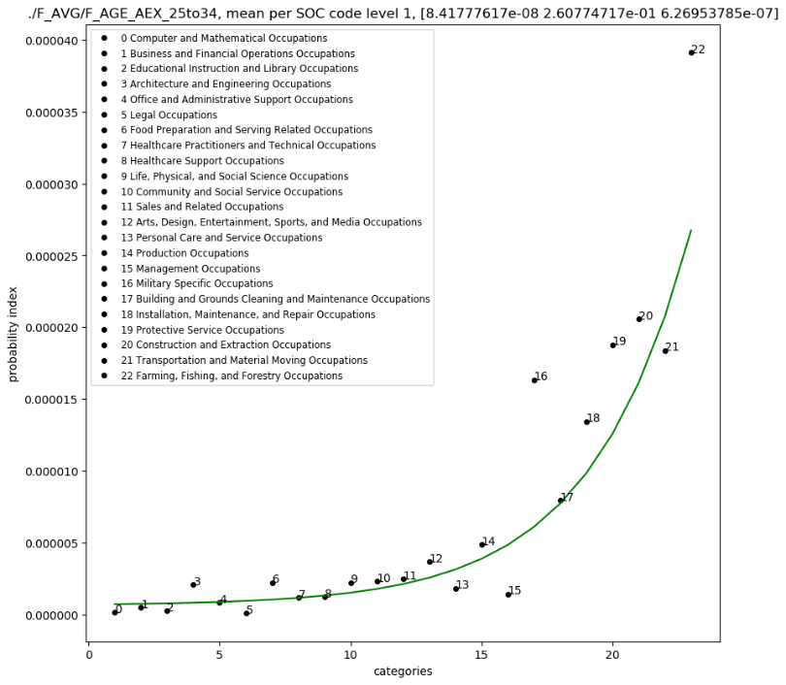
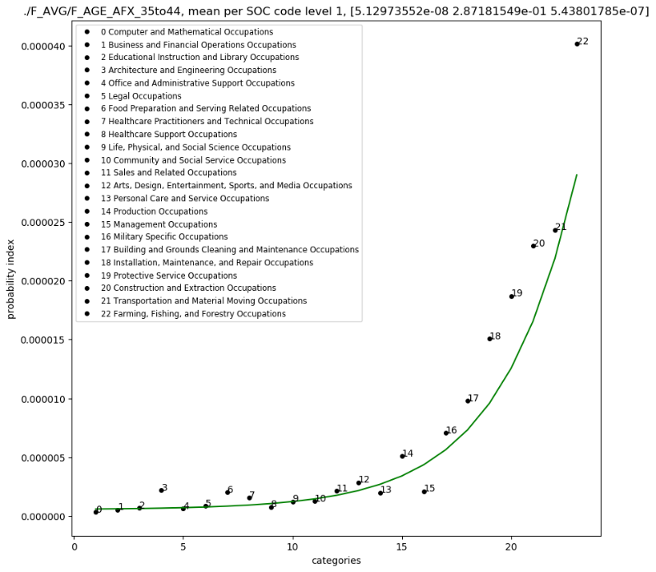
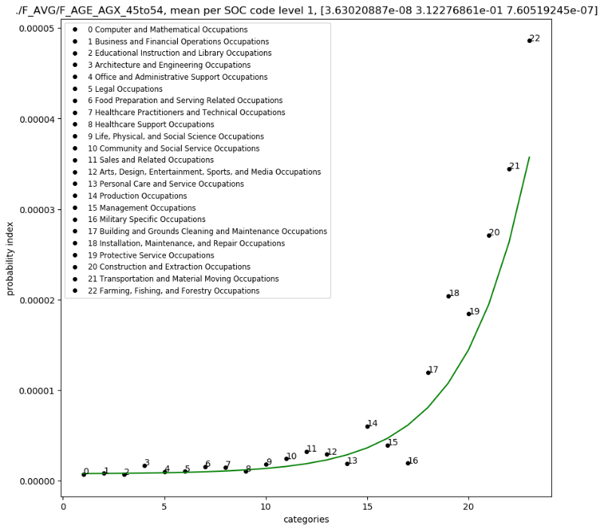
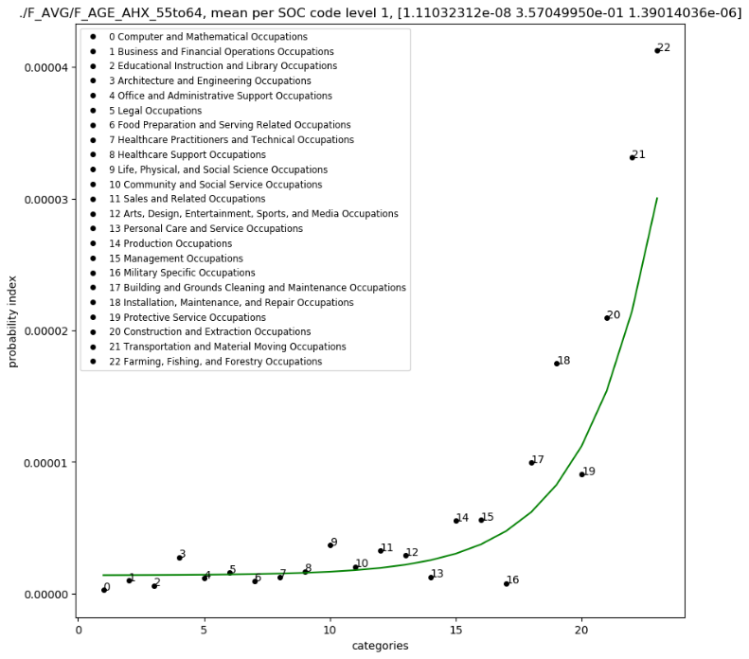
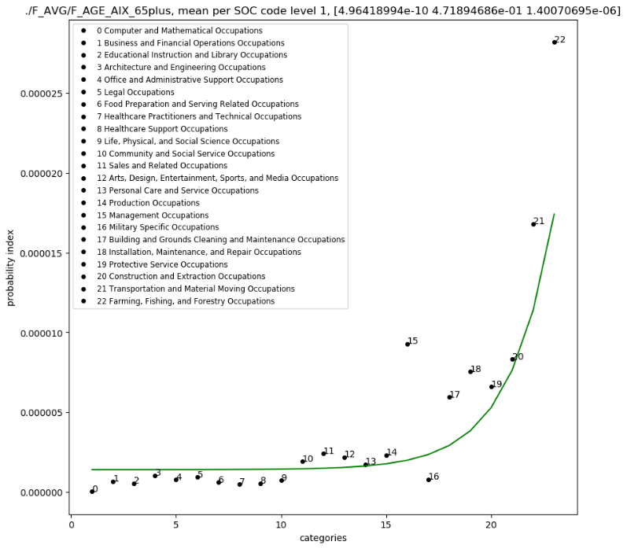
F_AGE, sorted by fatalities

Slide 10
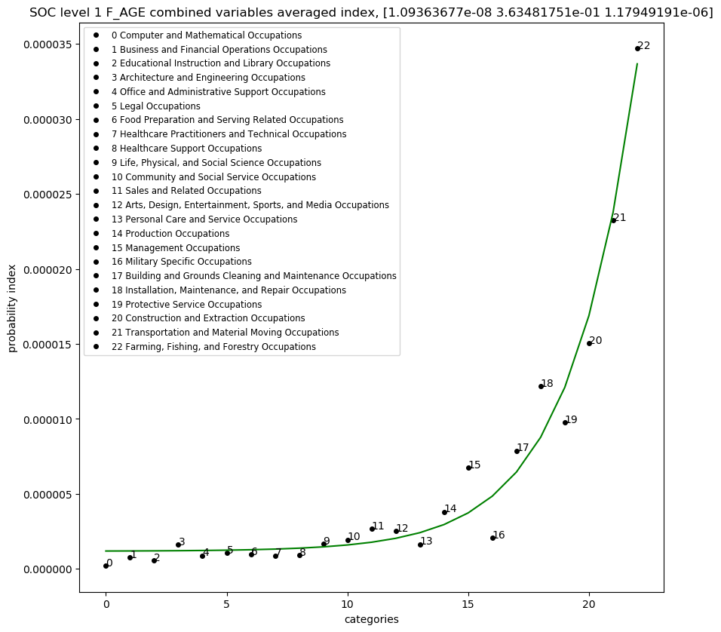
ALL F_AGE, sorted for fatalities

Slide 11
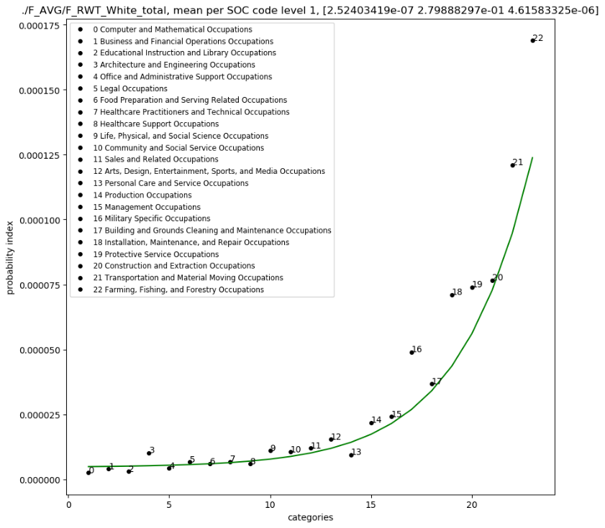
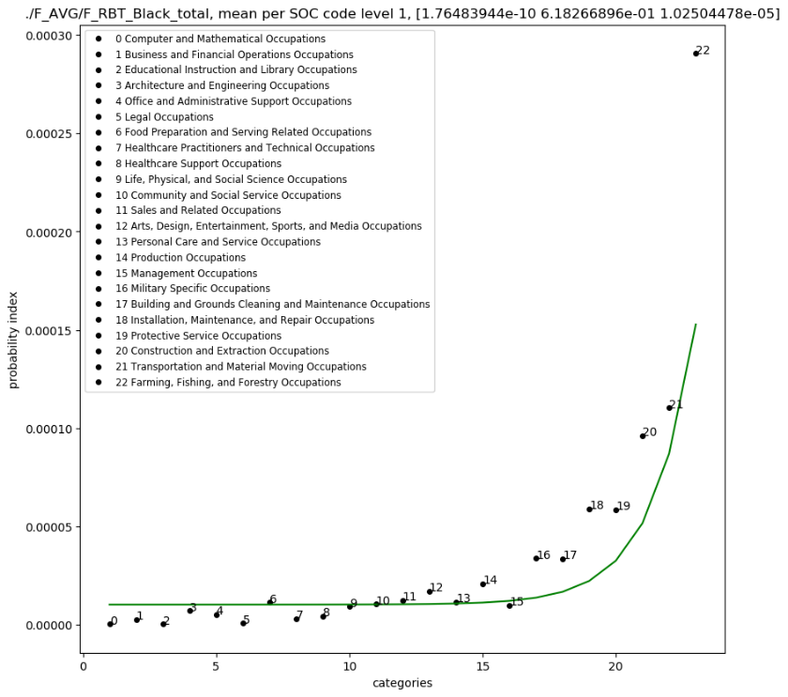
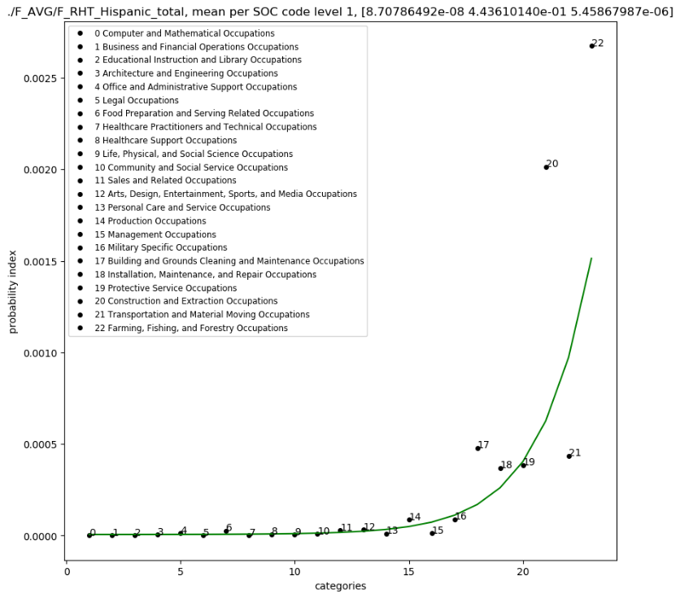
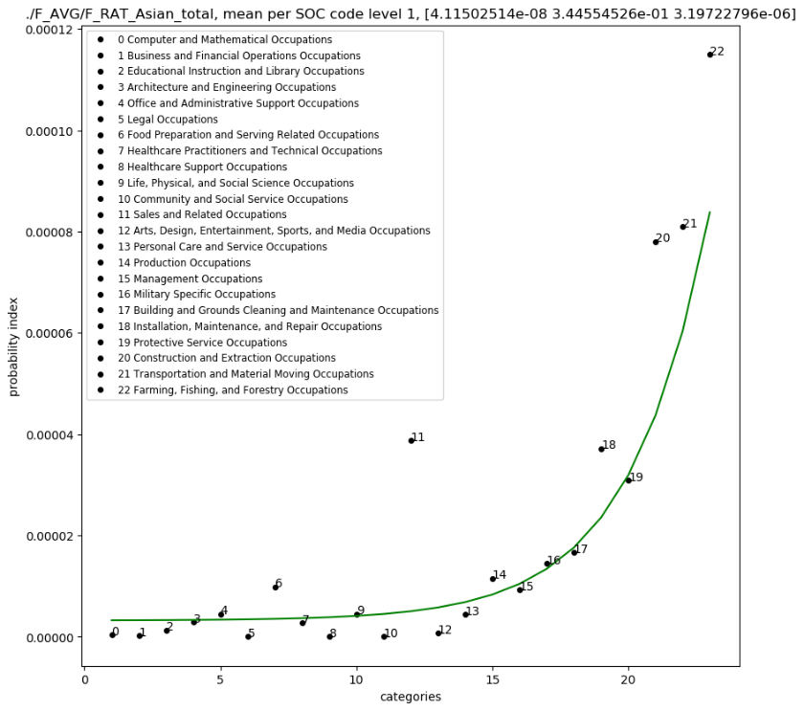
F_RACE, sorted by fatalities

Slide 12
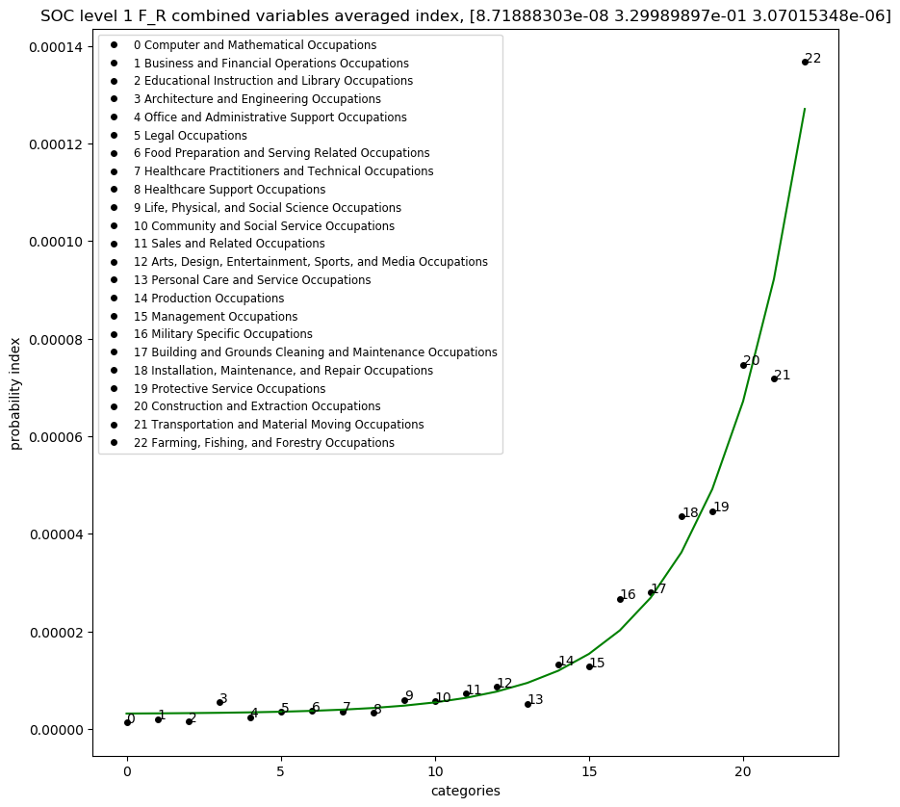
ALL F_RACE, sorted by fatalities

Slide 13
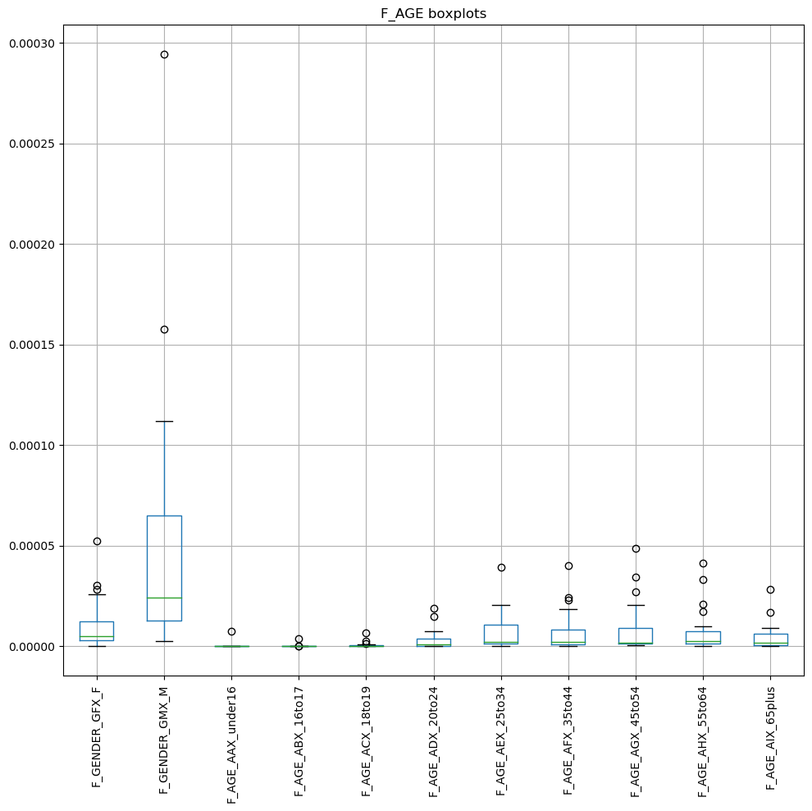
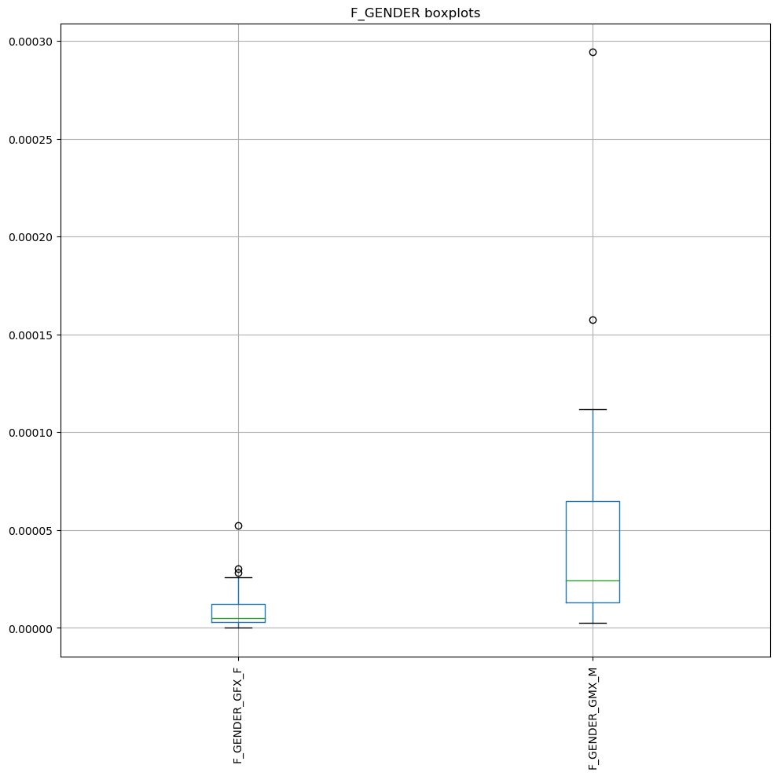
F_ALL_BOX PLOTS

Slide 14
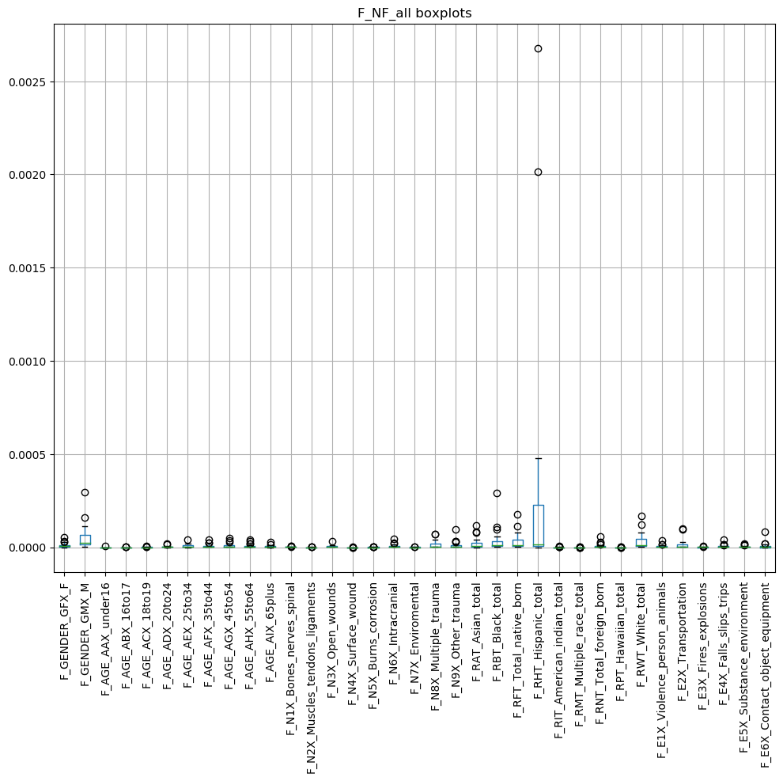
F_ALL_BOX PLOTS

Slide 15
Injuries (probability vs industry)

Slide 16
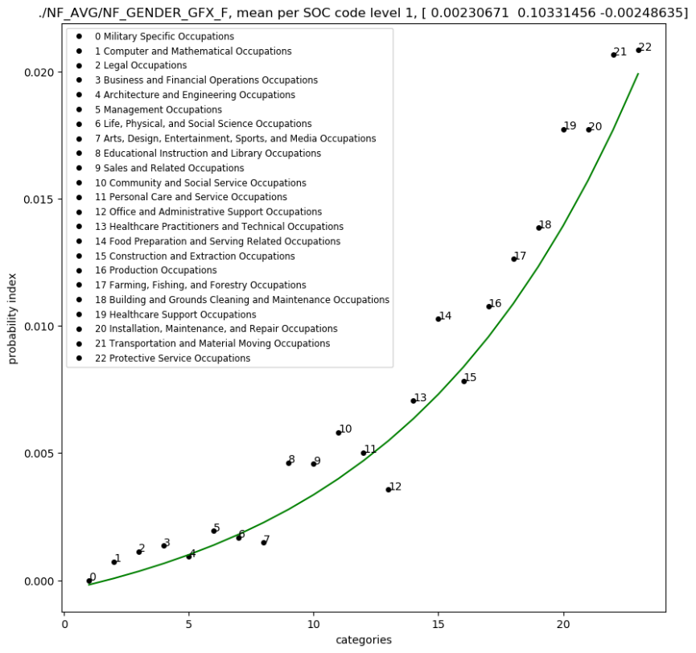
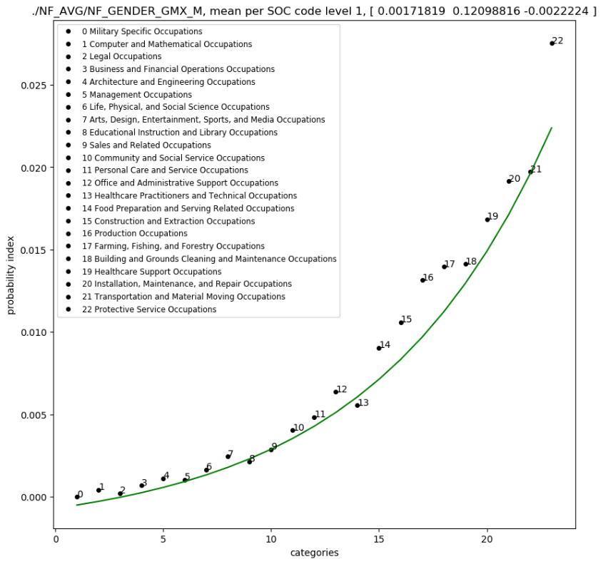
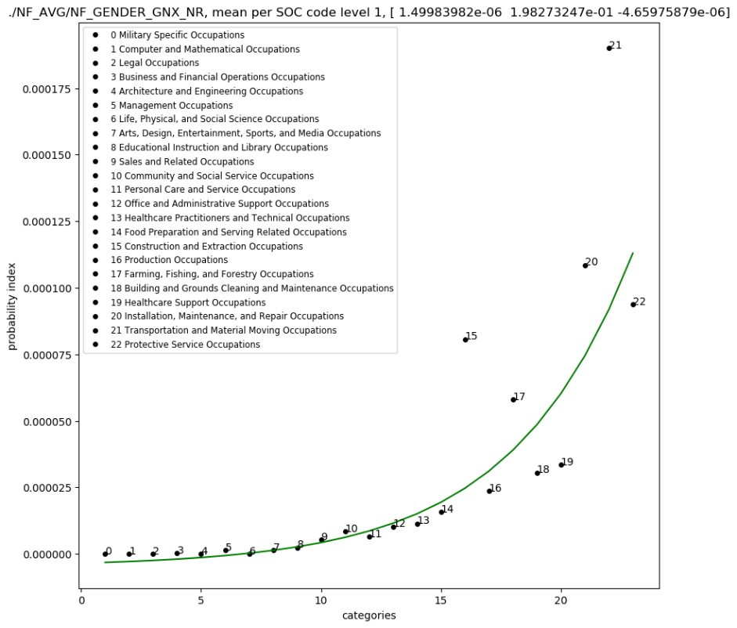
NF_GENDER, sorted for injuries

Slide 17
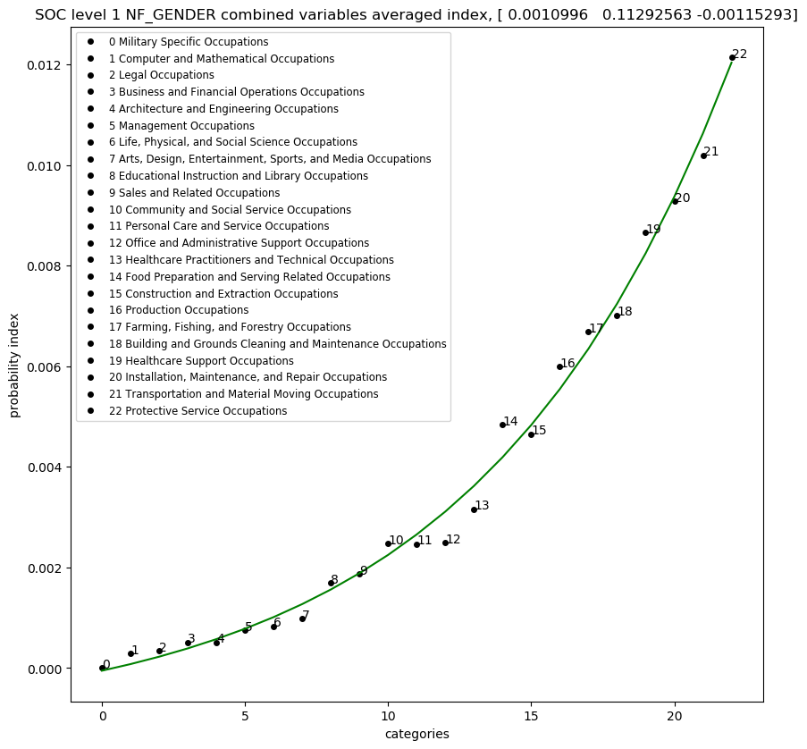
ALL NF_GENDER, sorted for injuries

Slide 18
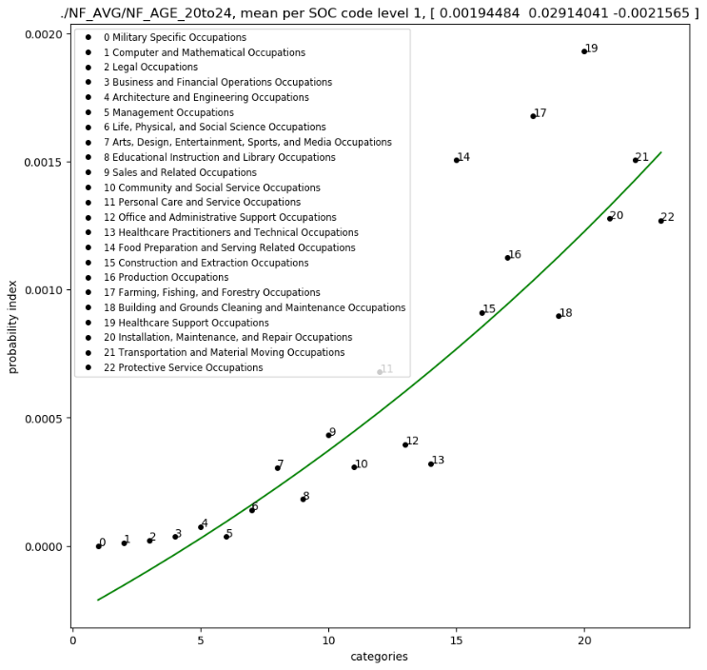
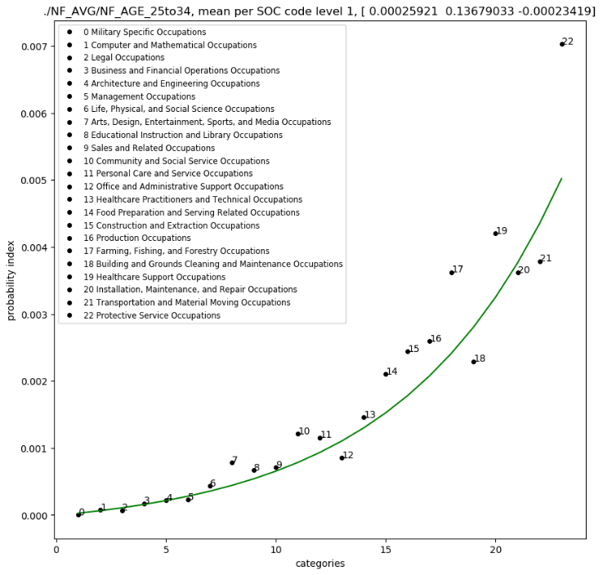
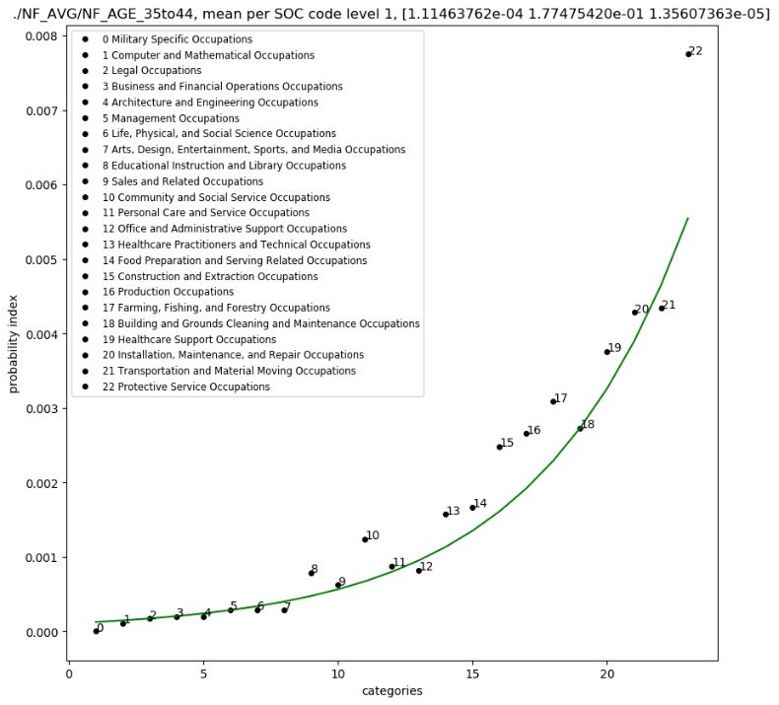
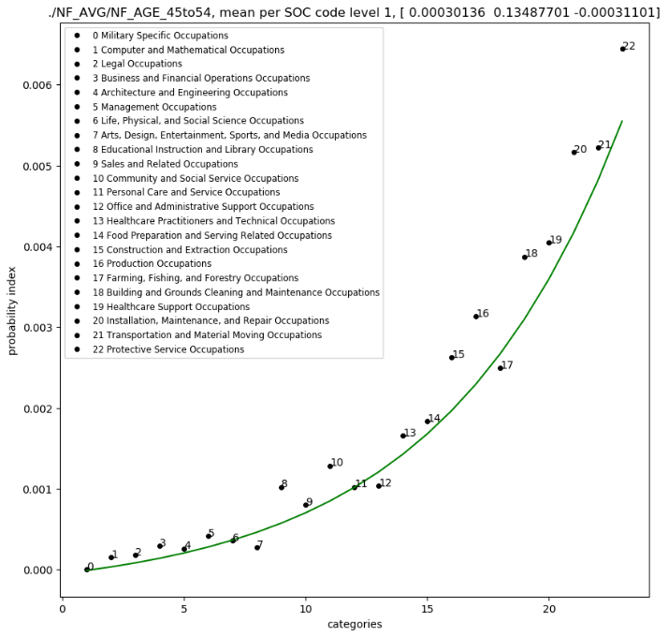
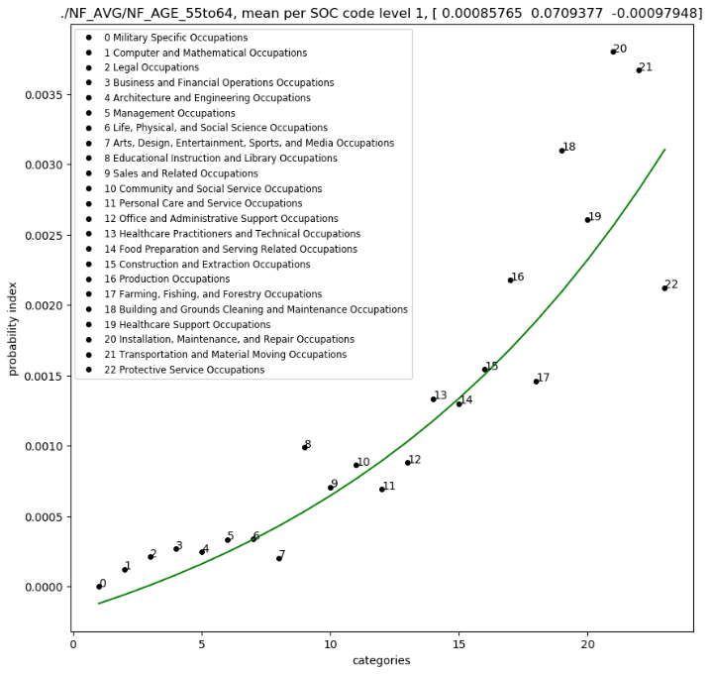
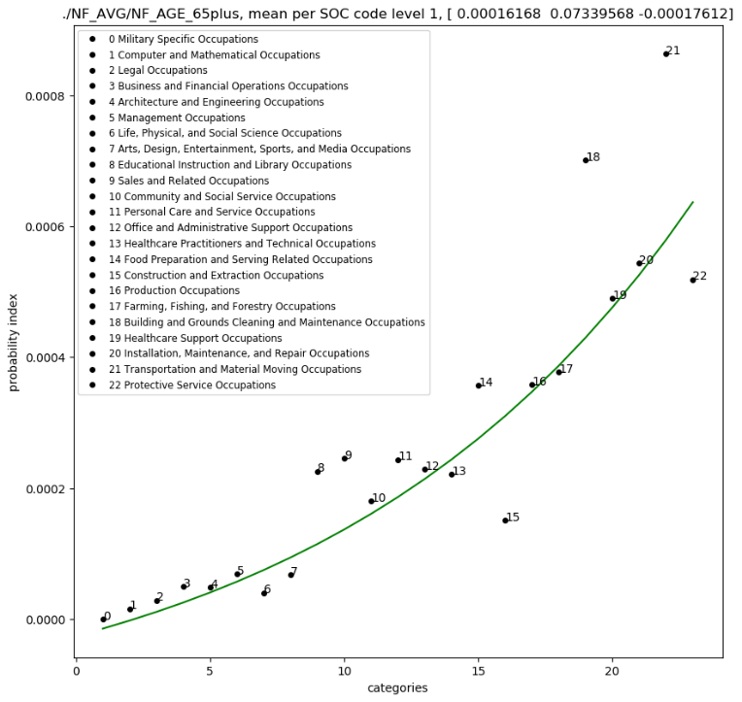
NF_AGE, sorted by injuries

Slide 19
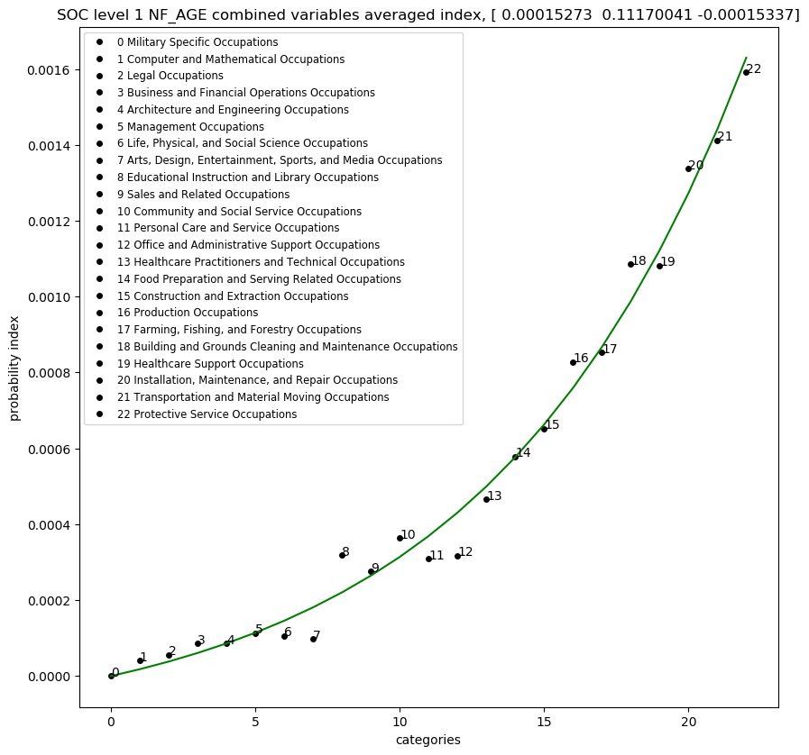
ALL NF_AGE, sorted for injuries

Slide 20
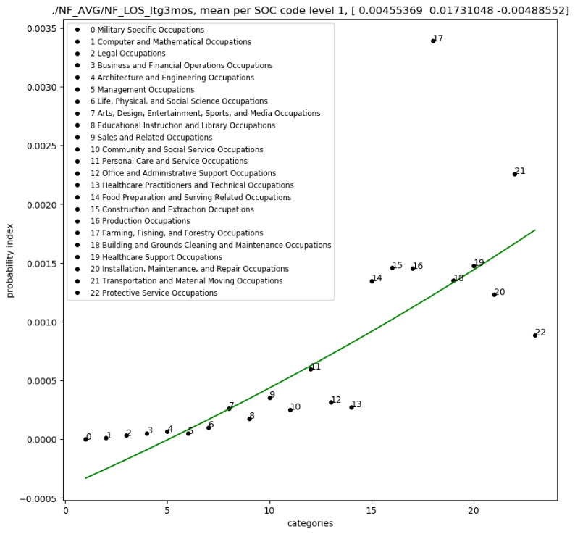
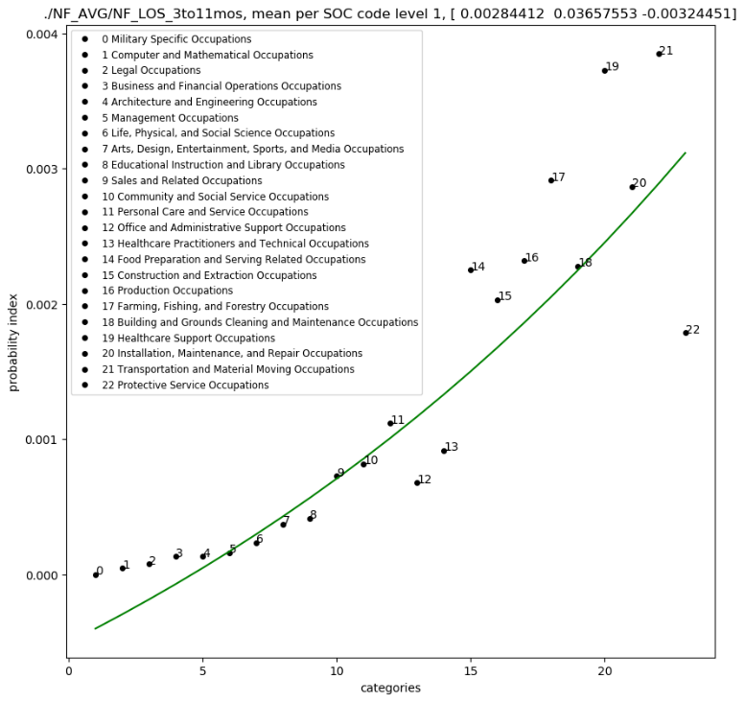
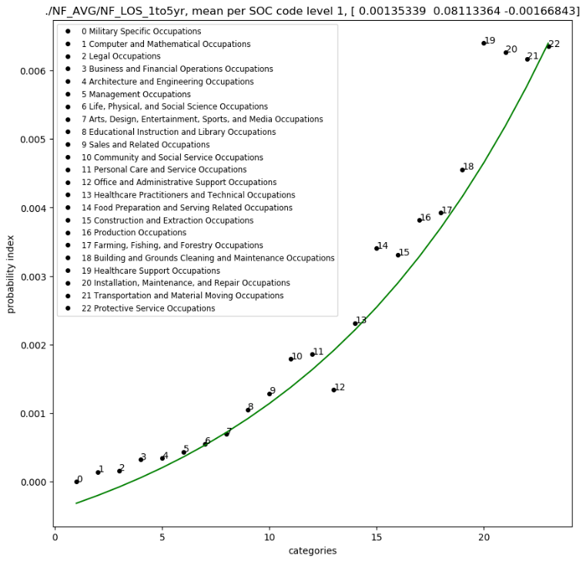
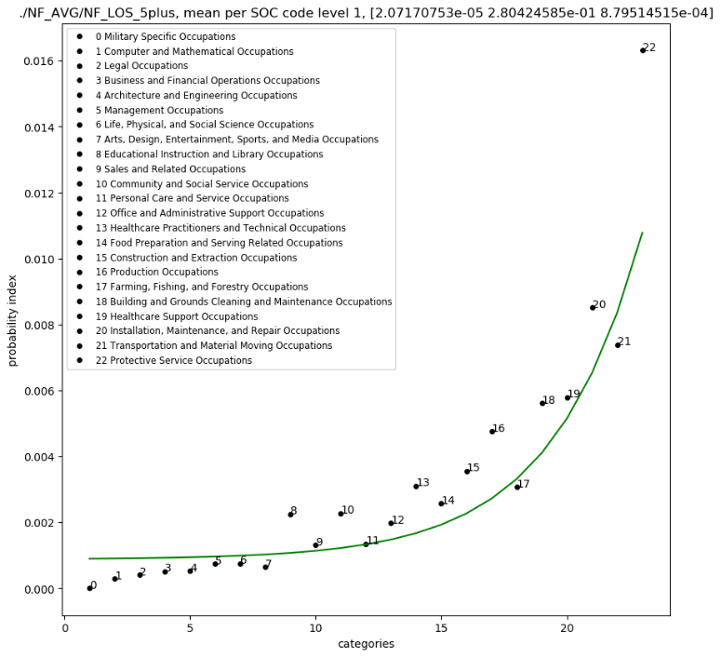
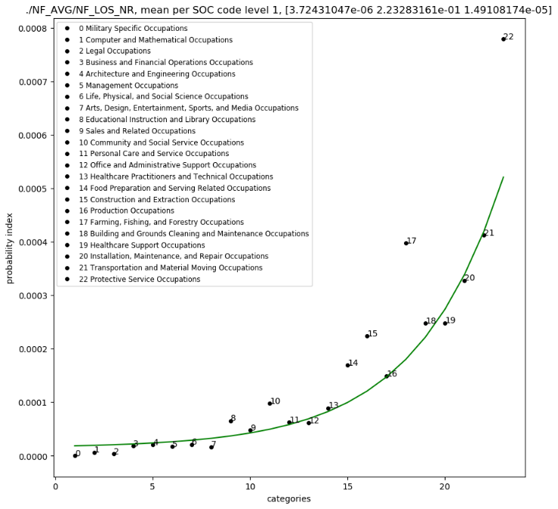
NF_LOS

Slide 21
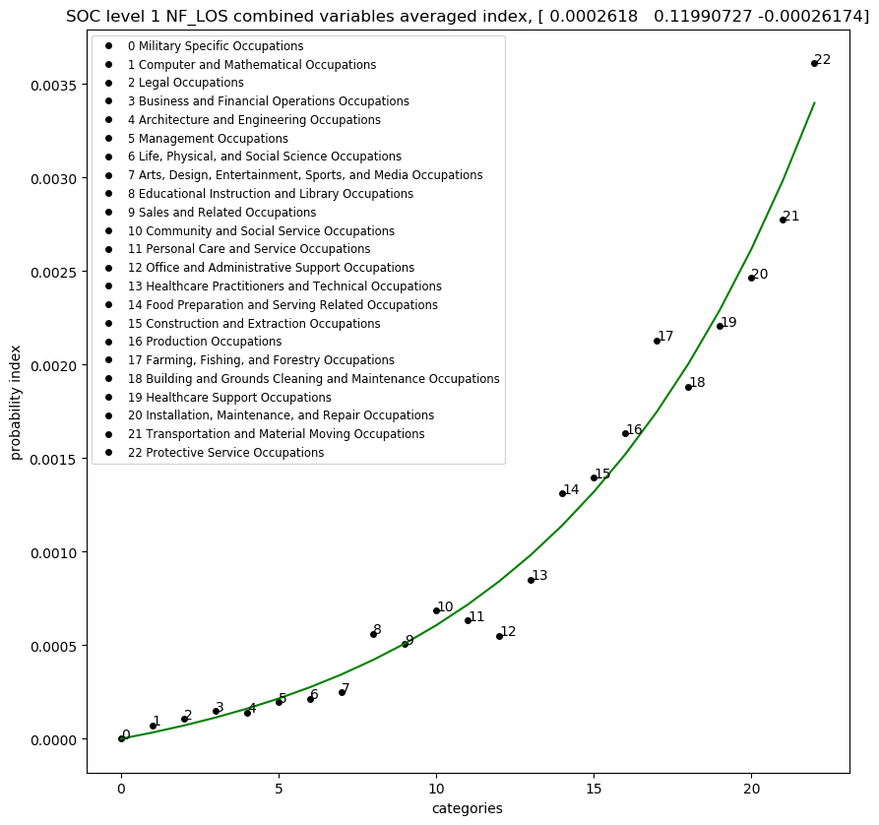
ALL NF_LOS, sorted for injuries

Slide 22
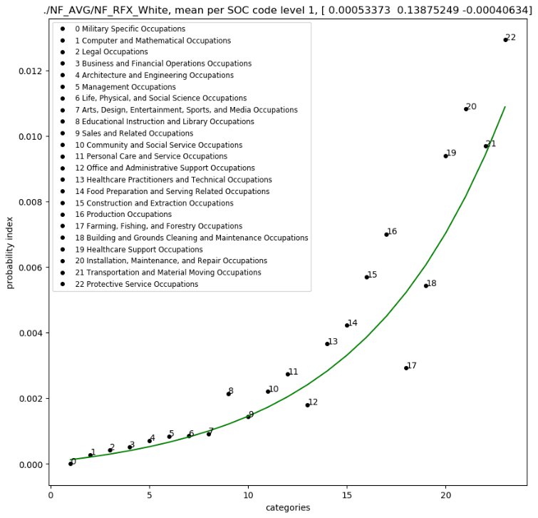
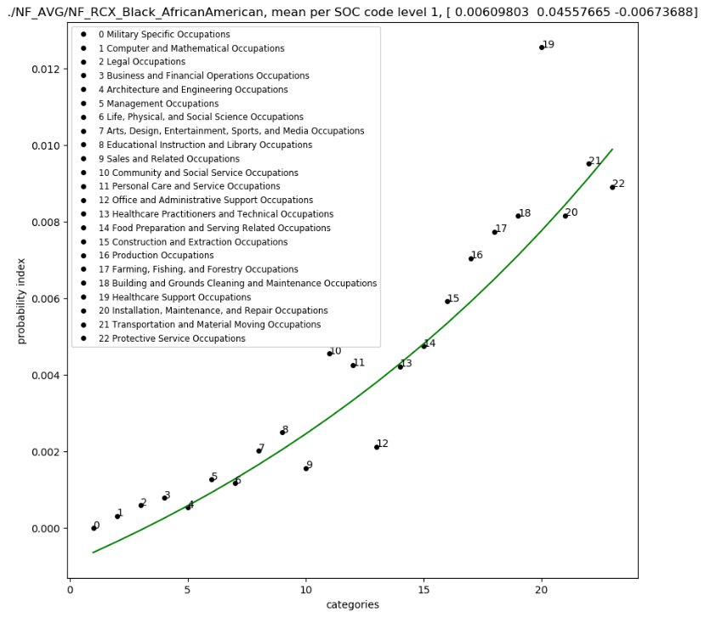
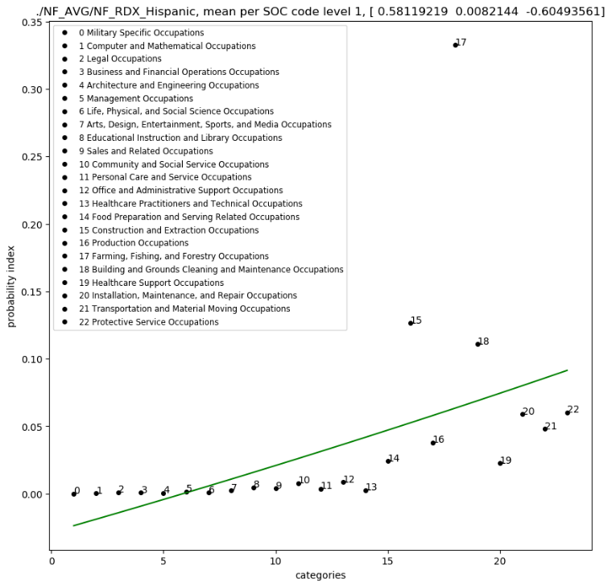
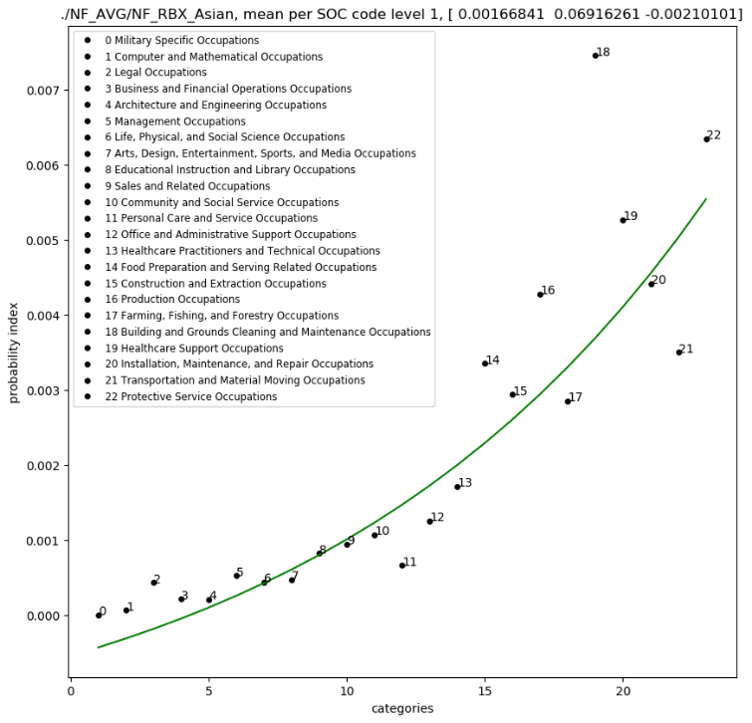
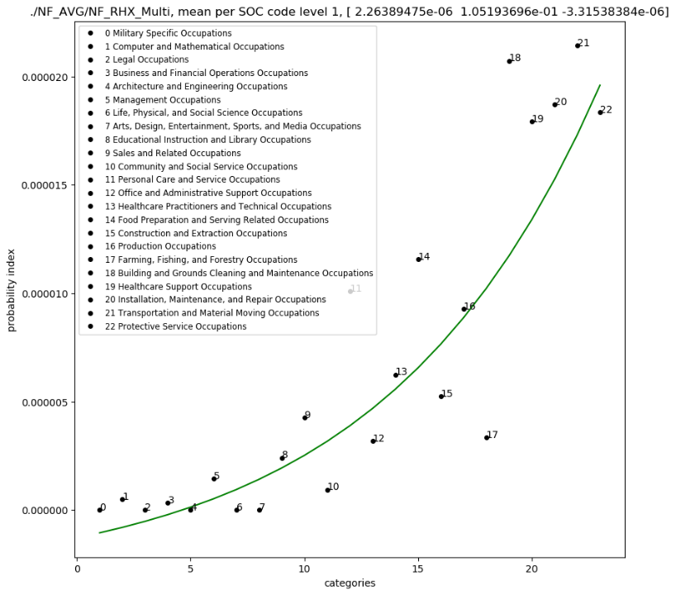
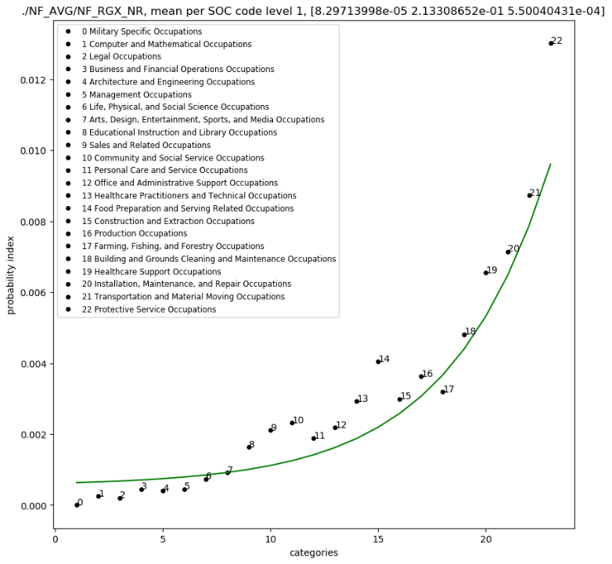
NF_R

Slide 23
ALL NF_RACE, sorted for injuries

Slide 24
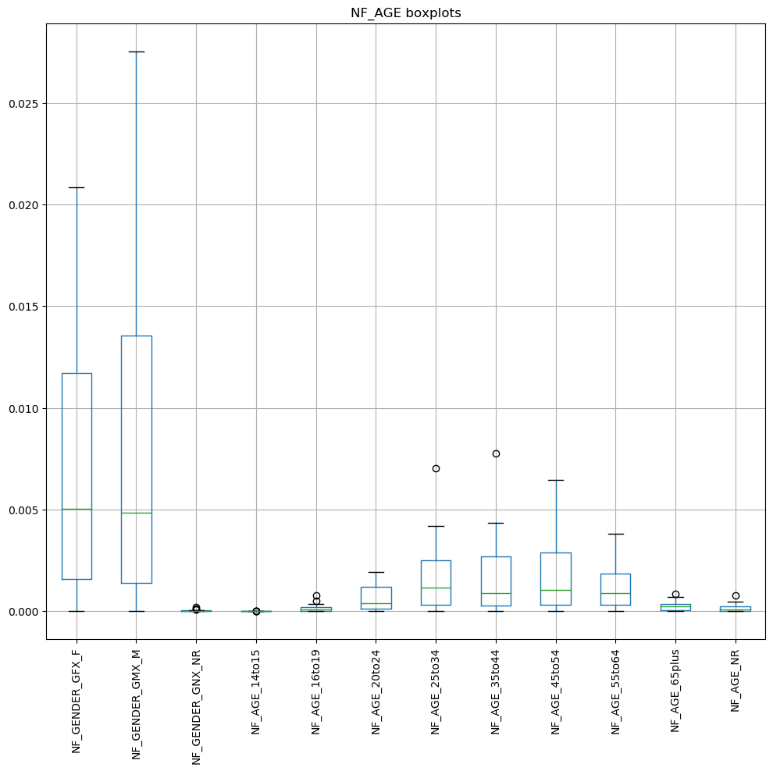
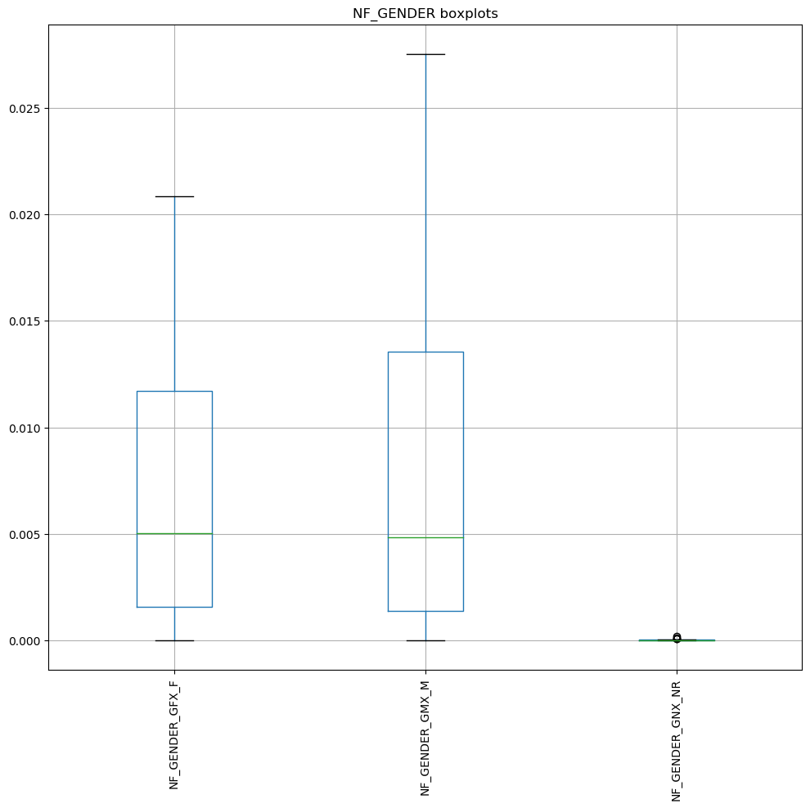
NF_BOX PLOTS

Slide 25
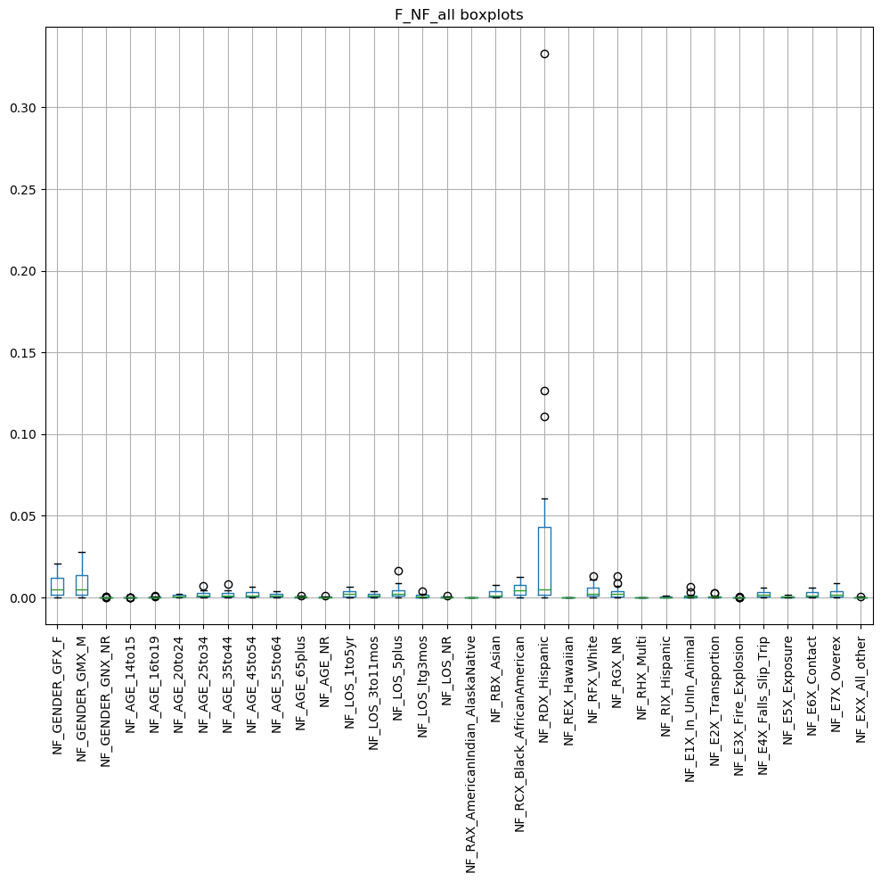
NF_ALL_BOX PLOTS

Slide 26
PEARSON CORRELATIONS

Slide 27
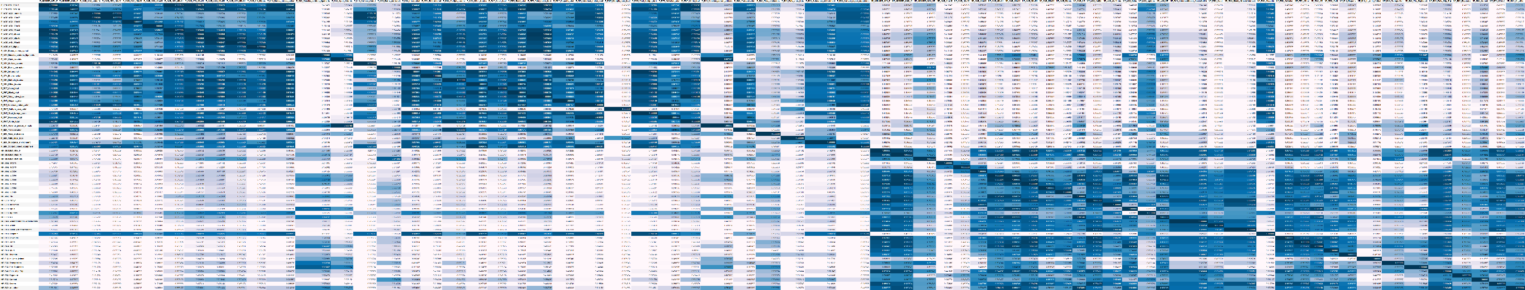
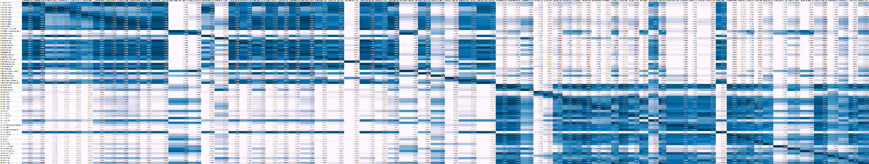
F-NF CORRELATIONS (sorted for fatalities)
NF-F CORRELATIONS (sorted for injuries)

Slide 28
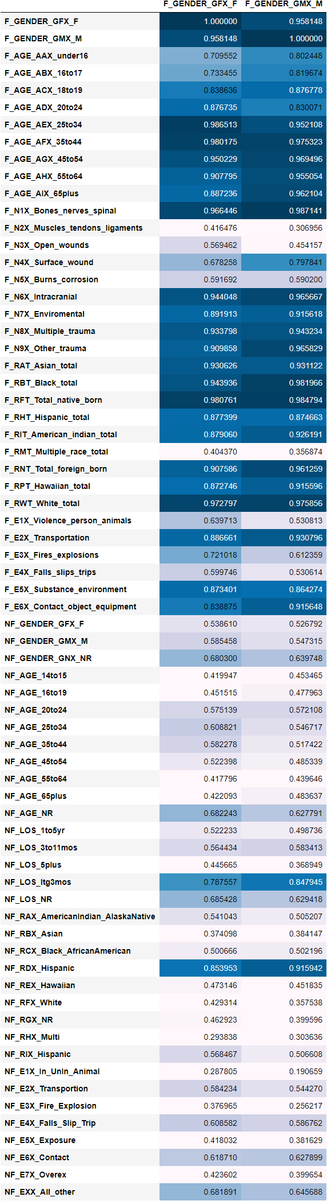
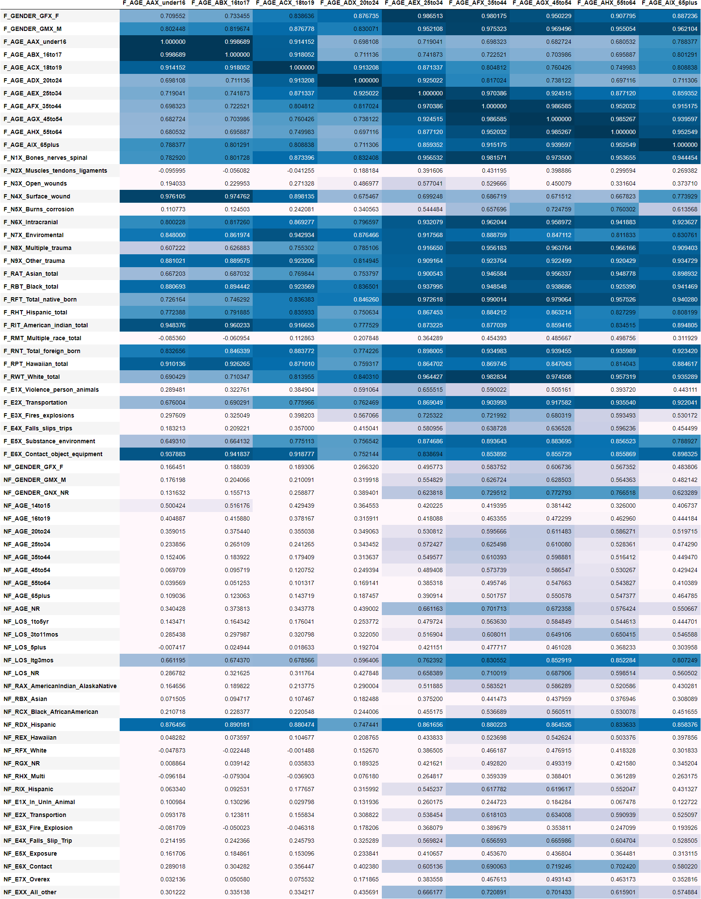
F-NF GENDER CORR
F-NF AGE CORR

Slide 29
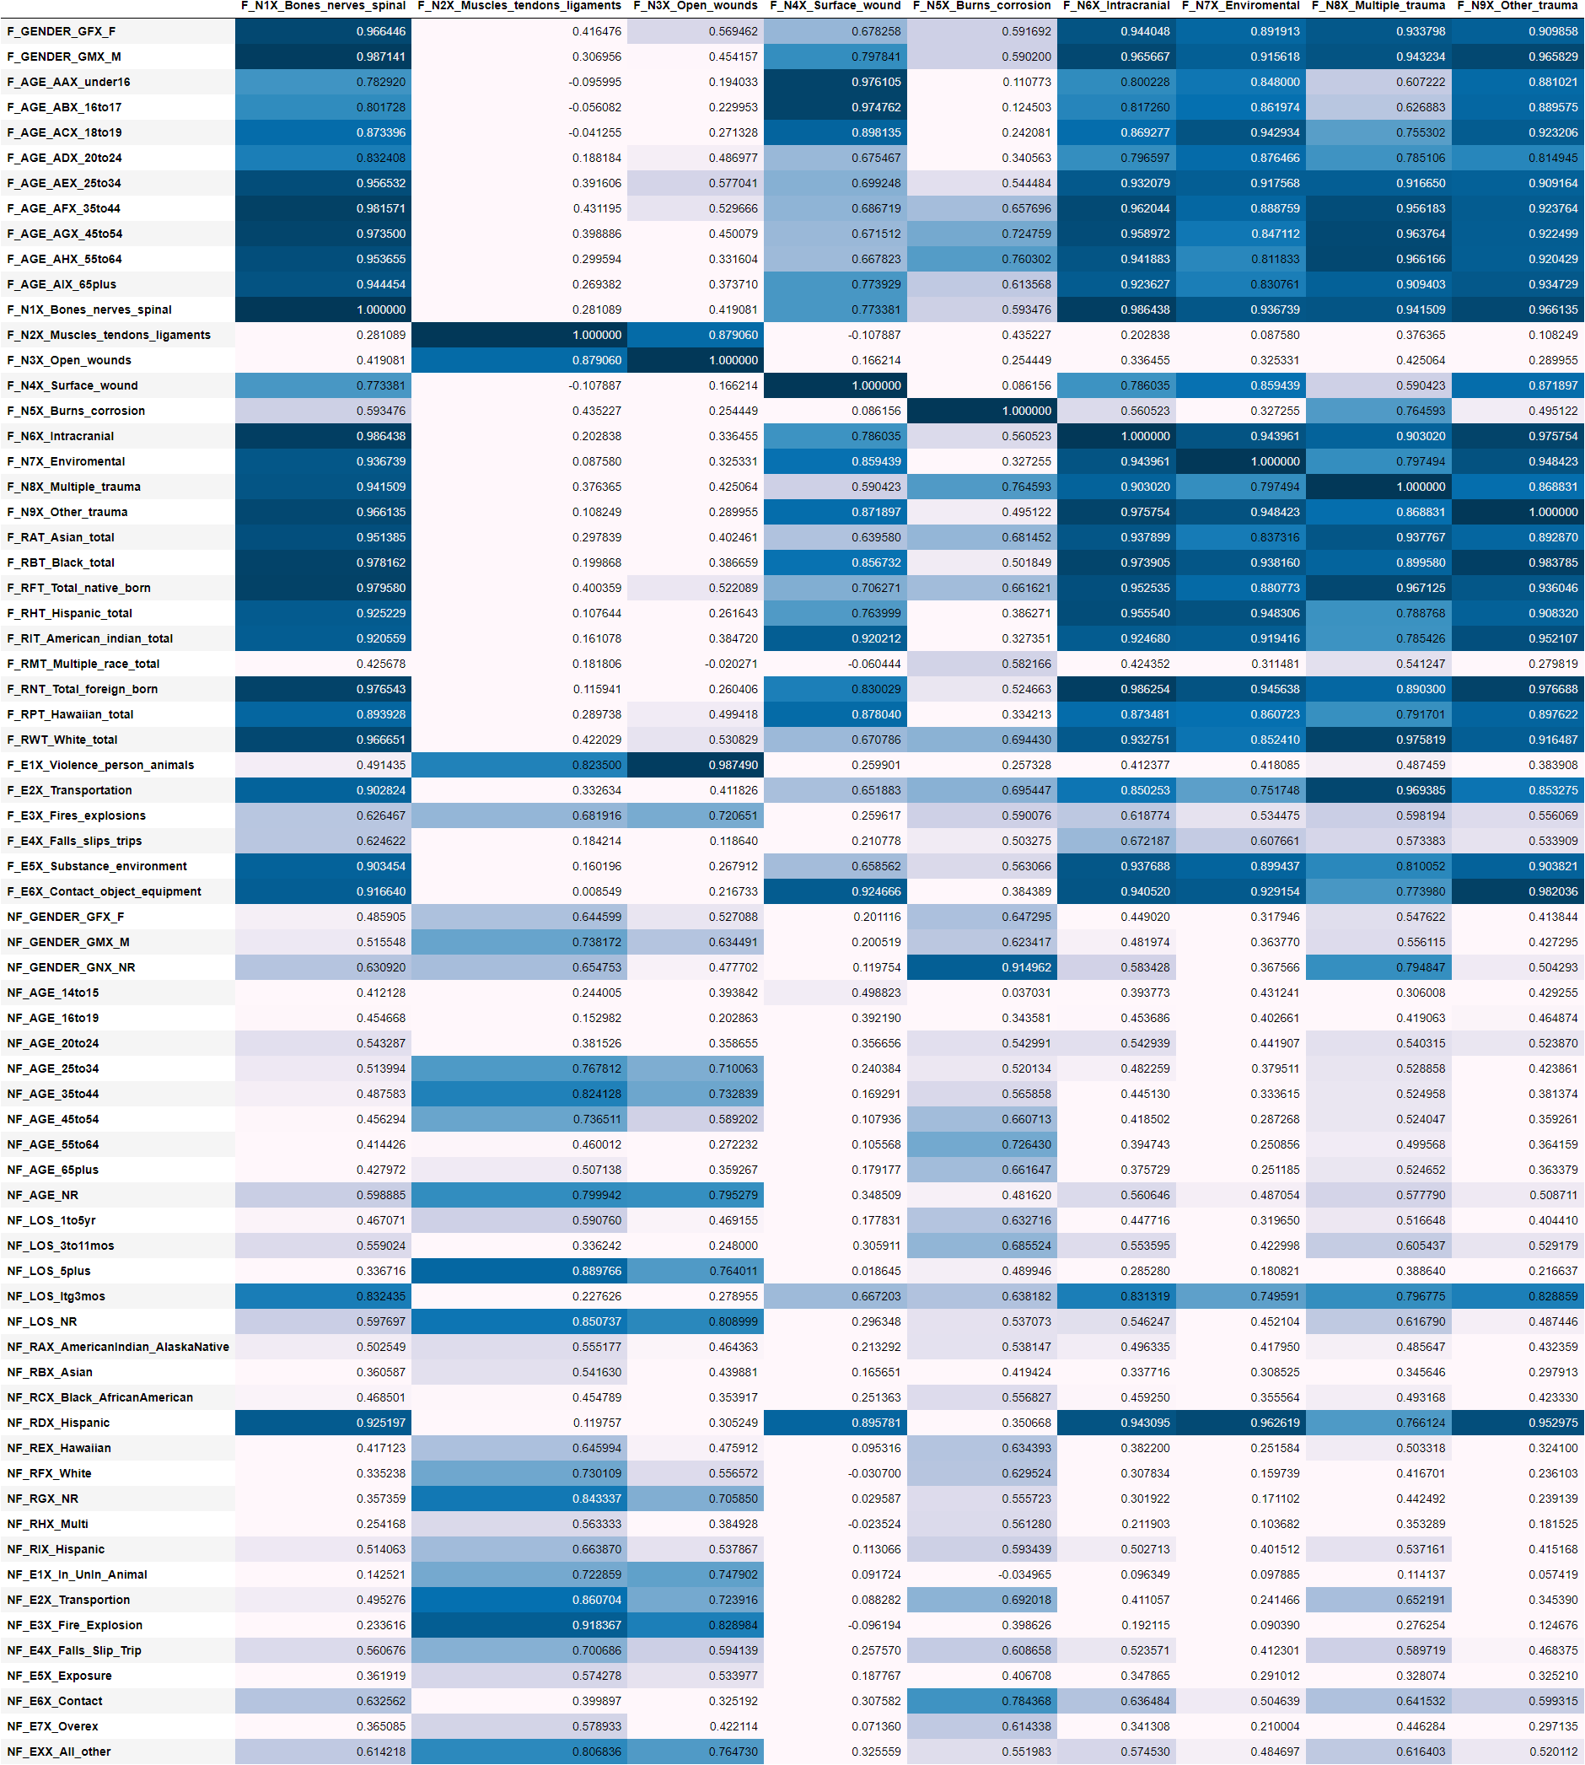
F-NF NATURE CORR

Slide 30
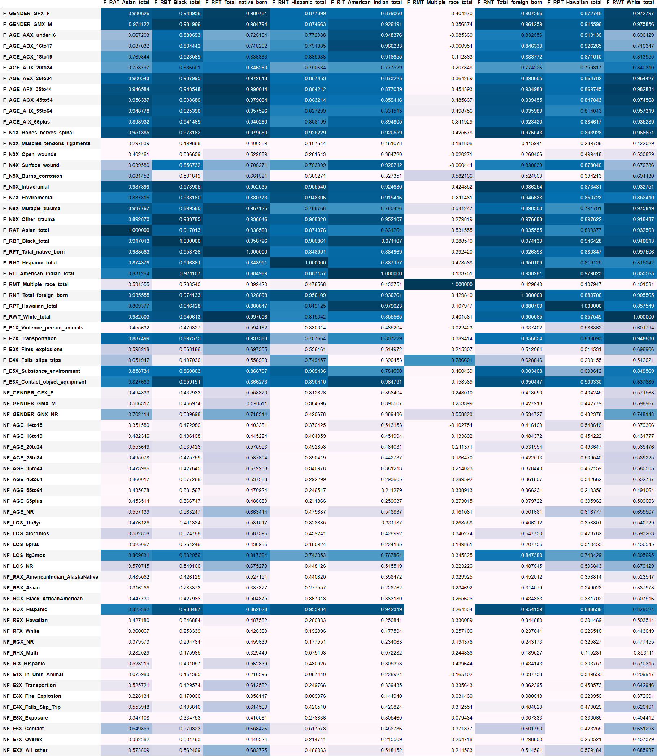
F-NF HISPANICS CORR

Slide 31

F-NF EVENTS CORR

